Slide 1
Lidt historieundervisning!
Unified Process (UP) – an alternative method and Use Cases
PAB - 2018

Slide 2
Agenda i dag!
Opfølgning fra sidst:
User Stories/how to demo/Acceptance test – klar?
Introduction to Unified Process – an alternative method
Core practices
Agile Unified Process
Comparison with Agile/Scrum
Goal
Understand the development of Methods.
Obtain general knowledge about basic principles in UP
Phases, iterations and increments
Use case driven
Risk driven
Be able to:
Specify requirements as use cases

Slide 3
For the project
Formulate at least 4 user stories for your project, they have to contain:
Name
Description
Acceptance criteria (with data)
Estimate the user stories

Slide 4
Software Development
Waterfall | UP | Agile (Scrum/XP)
Sequential Process All design up front Process heavy | Iterative Incremental Can be process heavy | Iterative Incremental Can be process light

Slide 5
UP is a generic process framework
UP is adaptable framework which can be specialized for a very large class of software systems
RUP (Rational Unified Process) is commercial IBM product http://en.wikipedia.org/wiki/Rational_Unified_Process
OpenUP is open source version
http://epf.eclipse.org/wikis/openup/
Basis Unified Process (BUP) is for small and agile projects https://www.eclipse.org/proposals/beacon/Basic%20Unified%20Process.pdf
Agile Unified Process (AUP) is another simplified version of UP http://www.ambysoft.com/unifiedprocess/agileUP.html
Many more versions exist – many companies have their own instance(s)

Slide 6
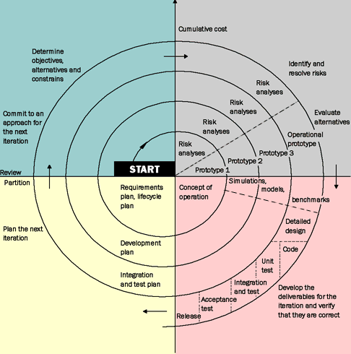
Background for Unified Process
Boehm’s spiral model

Slide 7
Unified Process Principles
Iterative and incremental
Use-case driven
Risk driven
Coverage
Risk
Business value
Architecture centric
Visual modelling
Demonstration based
Roundtrip engineering
RUP/UP is Use-Case driven and heavily reliant on the Unified Modelling Language or UML.

Slide 8
Iterative Development
Development is organized into a series of short fixed-length mini projects called iterations
The outcome of each iteration is a tested, integrated and executable system
An iteration represents a complete development cycle (mini waterfall): it includes its own treatment of requirements, analysis, design, implementation and testing activities
The system grows incrementally over time, iteration by iteration
But this you already know

Slide 9
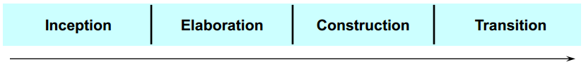
Phases of Unified Process
A Unified Process project organizes the work and iterations across four major phases:
Each phases has a mile stone:
Inception: Define the scope of project (incl. go/no-go)
Elaboration: Plan project, specify features, baseline architecture (price and time)
Construction: Build the product
Transition: Bring the system into use (technical and organizational)

Slide 10
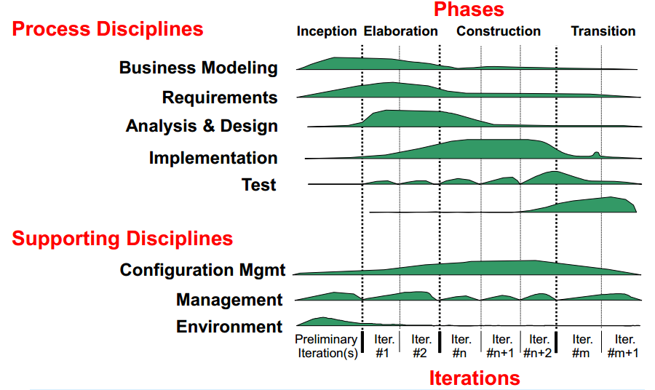
UP disciplines

Slide 11
In an iteration you
walk through all
disciplines
UP disciplines

Slide 12
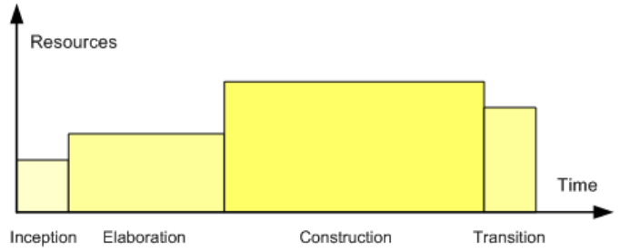
Relative Size of the Four Phases
Senior developers /architects establish architecture in the elaboration phase

Slide 13
UP <> SCRUM
 | UP | SCRUM
Approach | Iterative | Iterative
Cycle | Formal Cycle is defined across 4 phases, but some workflows can be concurrent. | Each sprint (iteration) is a complete cycle.
Planning | Formal project plan, associated with multiple iterations, is used. The plan is end-date driven and also has intermediate milestones. | No end-to-end project plan. Each next iteration plan is determined at the end of the current iteration (NOT end-date driven). Product Owner (Key Business User) determines when the project is done.
Scope | Scope is predefined ahead of the project start and documented in the Scope document. Scope can be revised during the project, as requirements are being clarified, but these revisions are subject to a strictly controlled procedure. | Instead of scope, SCRUM uses a Project Backlog, which is re-evaluated at the end of each iteration (sprint).
Artifacts | Vision/Scope Document, Formal functional requirements package, system architecture document, development plan, test plan, test scripts, etc. | The only formal artifact is the operational software and the user stories
Type of Project/ Product | Recommended for large, long- term, enterprise-level projects with medium-to-high complexity. | Recommended for quick enhancements and organizations that are not dependent on a deadline.

Slide 14
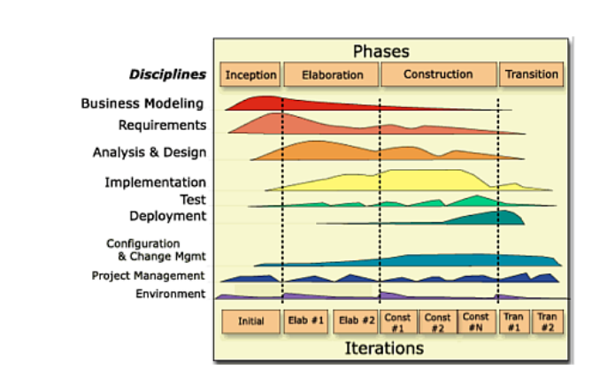
Exercise 1 – discuss with your neighbour
Where would you place Scrum/Agile in this UP figure?

Slide 15
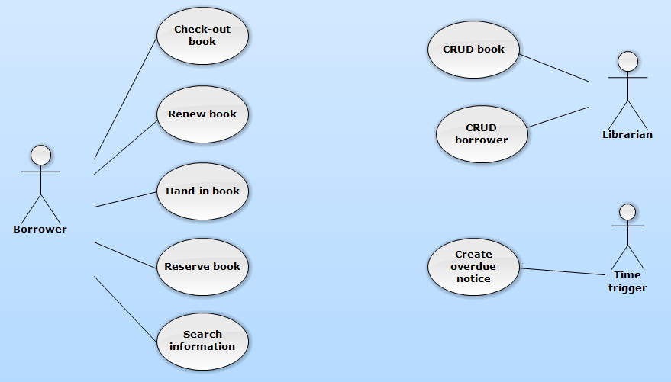
UP Core practises – use-case driven
Use cases capture the functional requirements of a system
Use cases describe the interactions between various actors and the system from the user’s perspective

Slide 16
Use case exercise I
According to your project:
Document requirements in an Use Case Diagram
Identify Use Cases & actors
Draw an Use Case-diagram

Slide 17
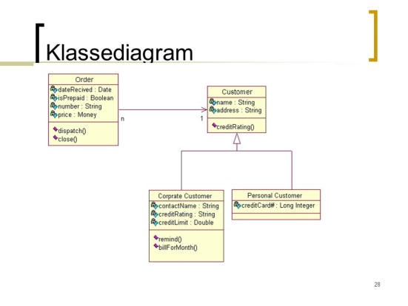
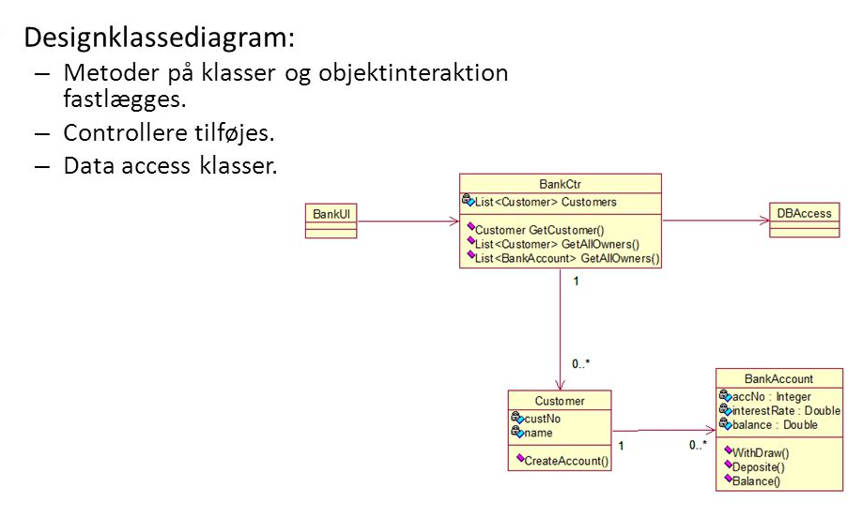
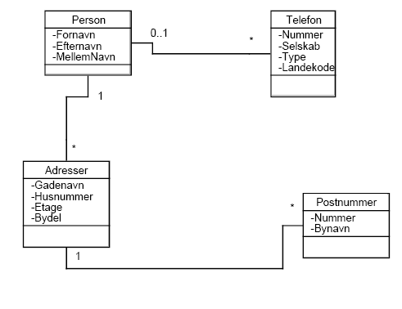
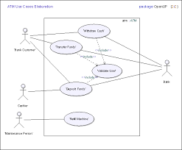
IT-systems lifecycle/development & UML
TEST
TEST
TEST
Decision and
contract
Production
Operation
more details
time
Domain model
Functional req.
Use Case Diagram
Class-diagram
Design-Class-diagram
Use Case Brief
Use Case Casual
Use Case Fully Dressed

Slide 18
Use case example – Check-out book
Primary actor: Borrower
Preconditions: The borrower must be created, the book(s) must be registered
Post conditions: The borrower is registered as having checked-out one or more books and the hand-in date for each is registered
Main success scenario:
The borrower arrives at the check-out desk with books to check-out
The borrower enters userID and pin code
The system validates userID and pin code
The borrower enters the bookID
The system validates the bookID
The system registers the book as checked-out by the borrower
The system calculates the hand-in date based on today’s date and borrow period
Step 4 – 7 is repeated until the borrower indicates that they are done
The system generates a receipt with name of the borrower, date, and for each book: Name of author, title, ID and hand-in date
The system logs off the borrower
The borrower leaves with the receipt and the checked-out books

Slide 19
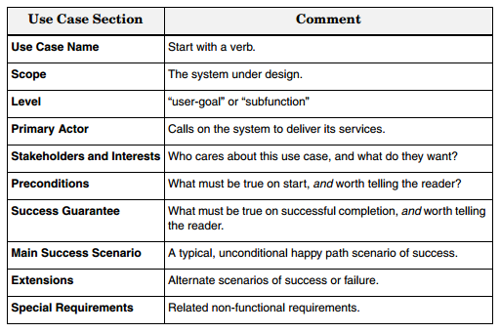
Use case description elements

Slide 20
Use case example: Borrow book (cont.)
Extensions (or alternative flows):
3a. If invalid userId or pincode
The system increments the number of erroneous entries
The requests the borrower to reenter userId and pincode if first or second erroneous entry
go to step 2
If third wrong userId or pincode log-out and lock user and resume start-op page
5a. If bookID cannot be validated
The system requests the borrower to contact personnel
5b. If the book has already been checked-out
...

Slide 21
User Stories <> Use Cases
User Stories | Use Cases
Promise of a conversation | Record of a conversation
A way of prioritizing work | A way of describing requirements
Demands questions | Demands answers
What & Why | How
Business | System

Slide 22
UP Core practises – risk-driven
Use cases are ranked according to the following criteria:
Architectural significant
If implemented, we are forced to design, build and test the core architecture
Business value
Features business really cares about
High risk
E.g. “be able to handle 500 concurrent transactions”

Slide 23
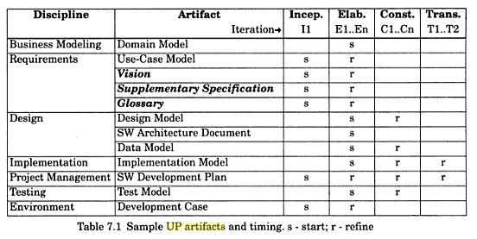
UP Core practises – Visual Modelling
UML modelling is central
An abstraction of the implementation (documentation)
A design tool (forward engineering)

Slide 24
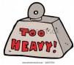

Customization of Unified Process
Many characterize UP as a heavyweight method, but almost everything is optional
All activities and artefacts (models, diagrams, documents …), except the code ☺
Invariant practices and principles
Iterative
Risk driven development
Continuous verification of quality
How to turn UP into agile version?
It is not meant by its creators to be heavyweight or un-agile

Slide 25
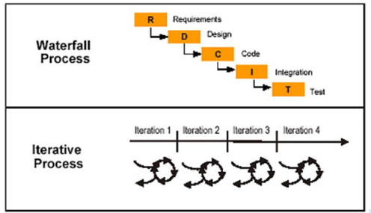
When Should you Use UP?
You could argue that you should use UP for:
Complex and sophisticated systems which evolve incrementally in cycles
You could argue that you shouldn’t use UP for:
Simple or well-known systems, where it might be feasible to sequentially define the whole problem, design the entire solution, build the software, and then test the product

Slide 26
Challenges in many IT projects
Business do have a need for a budget
Business do need a contract when buying software
Business do need to know when and what for their planning
EU tender rules
6 weeks to deliver your bid
Max. 20% of the requirements are allowed to be changed during the project

Slide 27
Agile Unified Process
Customizing UP
Prefer small set of UP activities and artefacts – keep it simple
Focus on early programming, not early documentation
Evolutionary Analysis & Design
Requirements and design are not completed before implementation
They adaptively emerge through iterations based on feedback
Agile models
Modelling must support understanding and communication, not documentation
Use simplest tool possible, e.g. sketching on whiteboard
Model in pairs – to discover, understand and share understanding
Use “good enough” simple notation; models will be inaccurate
Agile project management
No detailed plan for the entire project
High-level phase plan that estimates project end date and major milestones
Detailed iteration plans are done adaptively from iteration to iteration

Slide 28
Use case exercise II
Write a Use Case Description for one nontrivial user story related to your project including:
the specific user role for the use case
the sequence of events between the user and the system in each of the following situations
happy path
the system is unable to provide the requested service (alternative flow)
the user provides invalid input (alternative flow)
Guidelines:
as stepwise interactions between the actor and the system
as seen from the actors perspective
as actor intentions (not what is done on user interface - e.g. push xx-button)
use active verb (e.g. "actor selects type of item")

Slide 29
UP Exercise – prepare for examen!
List: Artefacts used in XP, Scrum and UP respectively
List: Activities carried out in XP, Scrum and UP respectively
List: Roles used in XP, Scrum and UP respectively
List: Similarities between UP and XP/Scrum
List: Differences between UP and XP/Scrum

